Slide 1
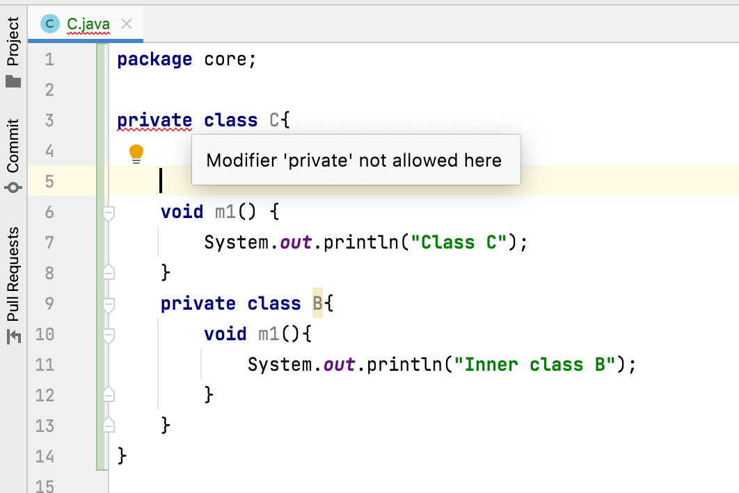
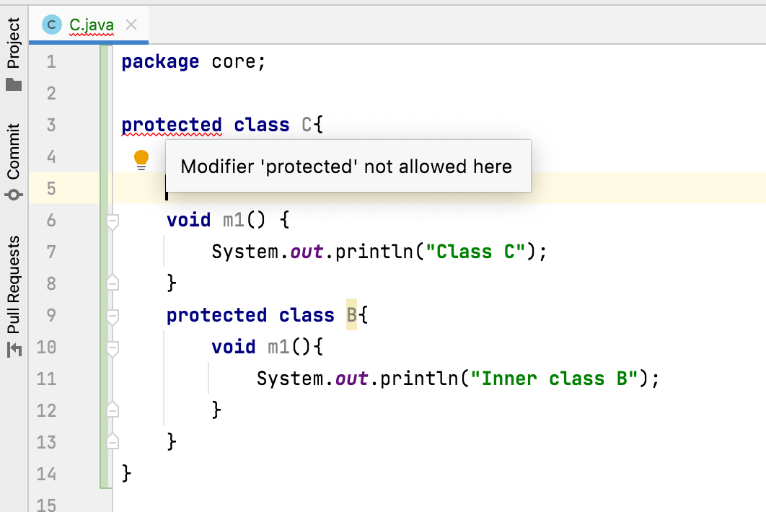
Can we declare a class as private or protected?
We can’t declare an outer class as private or protected.
But we can declare an inner class as private or protected.

